Slide 1

Functions
TUIT
C++ Programming, Fall 2016
Lab #6
(II - part)

Slide 2
Read the lecture notes doing following tasks:
TUIT
Practice (II - part)
*Search a character;
*Algebra: solve quadratic equations;
*Algebra: solve 2x2 linear equations;
***Current date and time;
Format an integer;
**Financial: credit card number validation;
*Decimal to Octal;
**Check substring;
**Occurrences of a specified character;
**Phone keypads;
** Binary to Octal
** Octal to Binary

Slide 3


TUIT
1. *Search a character
Write a function that searches for a particular character in a string using the following header:
void search(string& s, char& key)
Write a test program that prompts the user to enter the string and a character and displays if the character is found.
Here is a sample run:
Enter a string: Welcome to C++! Enter a character: + The + character is found in Welcome to C++!

Slide 4
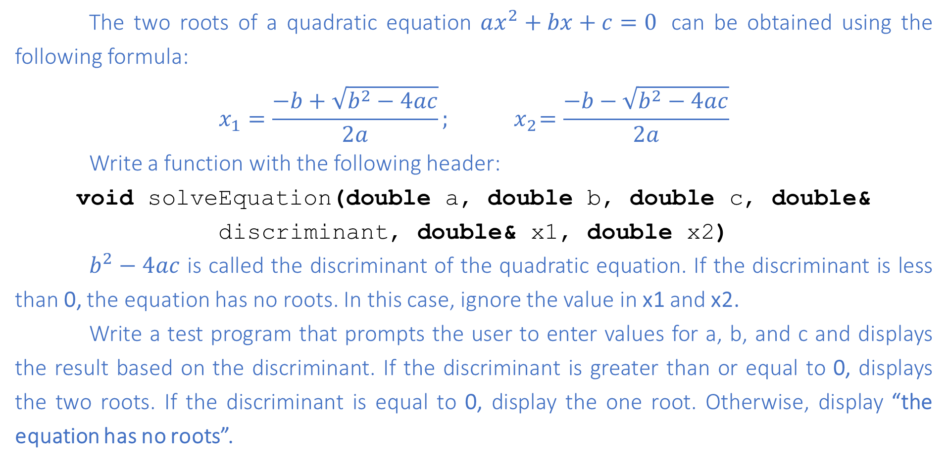
TUIT
2. *Algebra: solve quadratic equations
The two roots of a quadratic equation $ax^{2}+bx+c=0$ can be obtained using the following formula:
$$x_{1}=\frac{−b+\sqrt{b^{2}−4ac}}{2a};{ x}_{2}=\frac{−b−\sqrt{b^{2}−4ac}}{2a}$$
Write a function with the following header:
void solveEquation(double a, double b, double c, double& discriminant, double& x1, double x2)
$b^{2}−4ac$ is called the discriminant of the quadratic equation. If the discriminant is less than 0, the equation has no roots. In this case, ignore the value in x1 and x2.
Write a test program that prompts the user to enter values for a, b, and c and displays the result based on the discriminant. If the discriminant is greater than or equal to 0, displays the two roots. If the discriminant is equal to 0, display the one root. Otherwise, display “the equation has no roots”.

Slide 5

TUIT
3. * *Algebra: solve 2x2 linear equations
You can use Cramer’s rule to solve the following 2x2 system of linear equations:
$\left\{\begin{aligned}ax+by=e \\ cx+dy=f\end{aligned}\right. x=\frac{ed−bf}{ad−bc}, y=\frac{af−ec}{ad−bc}$.
Write a function with the following header:
void solveEquation(double a, double b, double c, double d, double f, double& x, double& y, bool& isSolvalbe)

Slide 6
TUIT
4. *** Current Date and Time
Invoking time(0) returns the elapse time in milliseconds since midnight January 1, 1970. Write a program that displays the date and time.
Here is a sample run:
Current date and time is January 16, 2017 10:34:23

Slide 7
5. Format an integer
TUIT
Write a function with the following header to format a positive integer with the specified width:
string format (int number, int width)
The function returns a string for the number with one or more prefix 0s. The size of the string is the width. For example, format(34, 4) returns 0034 and format(34, 5) returns 00034. if the number is longer than the width, the function returns the string representation for the number. For example, format(34, 1) returns 34.

Slide 8
TUIT
6. **Financial: credit card number validation
Credit card numbers follow certain patterns. A credit card number must have between 13 and 16 digits. The number must start with the following:
4 for Visa cards
5 for MasterCard cards
37 for American Express cards
6 for Discover cards
In 1954, Hans Luhn of IBM proposed an algorithm for validating credit card numbers. The algorithm is useful to determine whether a card number is entered correctly or is scanned correctly by a scanner. Almost all credit card numbers are generated following this validity check, commonly known as the Luhn check or the Mod 10 check. It can be described as follows. (For illustration, consider the number 4388576018402626. )

Slide 9
TUIT
6. **Financial: credit card number validation
Double every second digit from right to left. If doubling of a digit results in a two – digit number, add the two digits to get a single digit number.
4 3 8 8 5 7 6 0 1 8 4 0 2 6 2 6
2 * 2 = 4
2 * 2 = 4
4 * 2 = 8
Now add all single – digit numbers from Step 1.
4 + 4 + 8 + 2 + 3 + 1 + 7 + 8 = 37
Add all digits in the od places from right to left in the card number.
6 + 6 + 0 + 8 + 0 + 7 + 8 + 3 = 38
1 * 2 = 2
6 * 2 = 12 (1 + 2 = 3)
5* 2 = 10 (1 + 0 = 1)
8 * 2 = 16 (1 + 6 = 7)
4 * 2 = 8
Sum the result from Step 2 and Step 3. 37 + 38 = 75.
If the result from Step 4 is divisible by 10, the card number is valid; otherwise, it is invalid. For example, the number 4388576018402626 is invalid, but the number4388576018410707 is valid.

Slide 10
TUIT
6. **Financial: credit card number validation
Write a program that prompts the user to enter a credit card number as a string. Display whether the number is valid. Design you program to use the following functions:
// Return true if the card number is valid
bool isValid(const string& cardNumber)
// Get the result from Step 2
int sumOfDoubleEvenPlace(const string& cardNumber)
// Return this number if it is single digit,
// otherwise, return the sum of the two digits
int getDigit(int number)
// Return sum of odd-place digits in the card number
bool sumOfOddPlace(const string& cardNumber)
// Return true if substr is the prefix for cardNumber
bool startWith(const string& cardNumber, const string& substr)

Slide 11
TUIT
7. *Decimal to Octal
Write a function that returns a decimal number from an octal number. The function header is as follows:
int dec2Octal(const int& decimal)
Write a test program that prompts the user to enter a decimal number, uses the dec2Octal function to parse it into an equivalent octal number and displays the octal number.
Here is a sample run:
Enter a decimal number: 78 The 78 decimal number is equal to 116 octal number.

Slide 12
TUIT
8. * *Check substrings
Write the following function to check whether string s1 is a substring of string s2. The function returns the first index in s2 if there is a match. Otherwise, return -1.
int idexOf(const string& s1, const string& s2)
Write a test program that reads two strings and checks whether the first string is substring of the second string.
Here are some sample runs:
Enter the first string: welcome Enter the second string: We welcome you! indexOf(“welcome”, “We welcome you!”) is 3
Enter the first string: welcome Enter the second string: We invite you! indexOf(“welcome”, “We welcome you!”) is -1

Slide 13
TUIT
9. *Occurrences of a specified character
Write a function that finds the number of occurrences of a specified character in the string using the following header:
int count(const string& s, char a)
For example, count(“Welcome to C++”, ‘e’) returns 2. Write a test program that reads a string and character and displays the number of occurrences of the character in the string.
Here is a sample run:
Enter a string: Welcome to C++ Enter a character: o O appears in Welcome to C++ 2 times

Slide 14
TUIT
10. **Phone keypads
The international standard letter/number mapping for telephones is shown following. Write a function that returns a number, given an uppercase letter, as follows:
int getNumber(char uppercaseLetter)
Write a test program that prompts the user to enter a phone number as a string.
Here is a sample run:
Enter a string: 1-800-Flowers 1-800-3569377
Enter a string: 1800flowers 18003569377

Slide 15
TUIT
11. **Binary to Octal
Write a function that returns an octal number from a binary number. The function header is as follows:
int bin2Octal(const string& binaryString)
Write a test program that prompts the user to enter a binary number as a string and displays the corresponding octal value as string.
Enter a binary number: 1010 The 1010 binary number is equal to 12 octal number.

Slide 16
TUIT
12. **Octal to binary
Write a function that returns a binary string from an octal number. The function header is as follows:
string octal2Binary(const int& octalNumber)
Write a test program that prompts the user to enter an octal number, uses octal2Binary function to parse it into an equivalent binary string and displays the binary string.
Enter a octal number: 12 The 12 octal number is equal to 1010 binary number.

